Slide 1


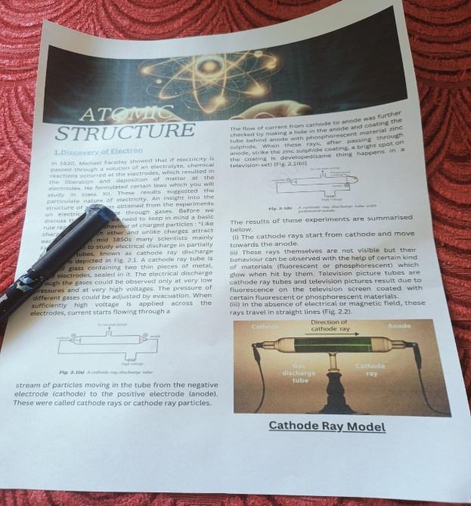
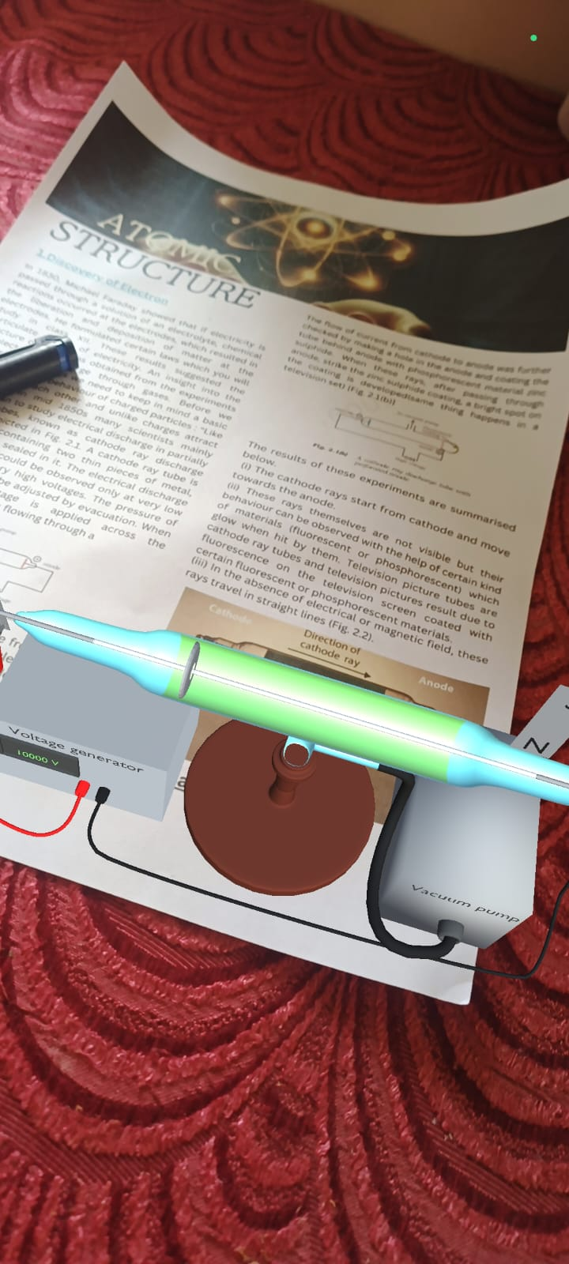

NUTAN MAHARASHTRA INSTITUTE OF ENGINEERING & TECHNOLOGY
“Augmented Reality In Education System”
Name of the Guide: Renuka Kajale
Names of Students : 1. Siddhi Rajendra Shinde 2. Ms. Anuja Pandharinath Kore 3. Mr. Sameer Ayub Shaikh
Session:2023-24
Abstract: 1. AR technology supplements traditional teaching methods by overlaying digital content onto the real world, there by enhancing engagement and comprehension.
2. In the educational context, mark-based image recognition facilitates a variety of interactive learning experiences.
3. For instance, students can scan marked images in textbooks to access 3D models, providing deeper insights into complex subjects.
INTRODUCTION & Problem Statements
Future Scope :
Augmented reality in education has a promising future with the potential to transform the way students learn and interact with information .
Accessibility – AR can provide personalized learning experience for students with disabilities ,helping them access educational content in new ways
Virtual Laboratories – AR can simulate real world environment
Methodology:
Experimental Setup:- Sketch
Future Scop & Methodology:-
Problem statement:
In traditional education settings, students often struggle to comprehend complex concepts when presented solely through 2D images. The limitations of static visuals hinder their ability to grasp spatial relationships, visualize abstract ideas, and engage with the material effectively. As a result, many students find themselves grappling with comprehension barriers, leading to frustration, disengagement, and suboptimal learning outcomes.
Introduction :
This paper provides an overview of augmented reality in education, highlighting its benefits, challenges, and potential applications. It explores how AR can be used to create interactive simulations, virtual field trips, and personalized learning experiences. Additionally, the paper discusses the role of AR in promoting student engagement, collaboration, and critical thinking skills.
At the heart of AR technology lies the concept of marking base images, a fundamental process that facilitates the augmentation of reality. To put it simply, marking base images involves assigning digital content – such as 3D models, videos, or textual information – to specific real-world objects or markers.
Input Output
Input
The flow chart shown in Figure explains the work methodology for this work
Proposed Work Methodology (Flow Chart)
Marker Image 3D Model
Define learning Objectives
Research and Analysis
Implementation
BLENDER: it is the free and open source 3D creation suite. with the help of blender we are making 3D models. Later on We export this model in the Unity 3D.
UNITY 3D : Unity’S AR Foundation is a cross-platform framework that allows you to write augmented reality experiences once, then build for either Android or iOS devices without making any additional changes. We import this 3D model in UNITY . And developed AR application.
AR technology selection
AR Development
Deployment and Launch
Testing and Validation
Conclusion
Augmented reality has the potential to revolutionize the education system by in education.
Augmented reality has the potential to revolutionize the education system by providing innovative and immersive learning experiences. This project aims to harness the power of AR to enhance learning outcomes, increase engagement, and improve accessibility in education.

